Slide 1
Analyzing transaction data to gain sustainable insights based on carbon footprint: A proof of Concept
Project Group / Study conducted by
Shubham Ingole
s200092
Prasad Jagtap
s200109
MSc in Engineering, Business Analytics
Department of Management Engineering,
Technical University of Denmark
Notes:
Hello All, thanks for giving this opportunity and allowing us to present today. Myself Shubham and My co presenter Prasad will be presenting our thesis.
Our topic of study was:

Slide 2


Acknowledgements
Kathrin Kirchner
Thesis Supervisor
Emilie Lundblad
Company Supervisor
Marie Louise Møllebæk Pollmann-Larsen
Thesis Co-Supervisor
Tim Deynen
Company Co-Supervisor
Notes:
We would like to acknowledge the help, constant support given by our superviour over the period. We were exteremly thankful for our supervisours.

Slide 3

01 Introduction
02 LITERATURE findings
03 METHODOLOGY & analysis
Agenda
04 Results
05 Discussion
06 Conclusion
07 Future Scope
A appendix
Notes:
Todays agenda resemble our thesis report, we have will be going through introduction, ..................

Slide 4
01. Introduction
Notes:
What is the topic area that you are investigating?
What are the specific research questions that you set out to answer?
Research questions (Kasper)
Why is this question important to answer?
The need for this study – motivation (Kasper)
What were the objectives of your research?

Slide 5





iNTRODUCTION
Global warming crises becoming a major concern and needs effective actions to lower the impact.
Joint effort in taking climate actions, with the goal of providing a solution that can be used to mitigate the emissions that cause global warming.
An exploratory analysis-based tool could be leveraged to estimate real-time emissions and impact with regular transactions.
To take actions, one first needs to identify how much impact they are making and what are the challenges.
Notes:
Global warming crises are gaining traction also attention of policy makers to lower the impact. All over the world, form local to global org or an particular individual willing to take actions. But it require a joint effort and a mojor impact could be done by organizations or individuals.
We as sustainbility enthusiast, and analytics background student wated to contribute in making an effort. This is where we collaborated for this project idea with green house.
In order to take actions we must understand what and how we are impacting.
Thus we scoped our project to devlop a exploratory analysis based tool that could estimate carbon emission with regular spendings.

Slide 6
Research Objective
Analyze transaction data to develop an interactive user-accessible dashboard that shows sustainable insights.
What are the pre-requisites required to calculate carbon emission by using transaction amount/data?
What are the relevant KPIs to consider in order to develop insights in the dashboard?
In what way data analysis platforms can be leveraged to develop user-accessible dashboards?
Notes:
Our main objective of the study was to analyze transaction data, so that we can build a interactive visualiaztion based dashboard that can show sustainable insights based on emissions.
In order to attain those, we need to find out what how we could such analysis or what calcualtion are required.
It was important to indentify what KPI are required that can show the relavant or important information.
And how or what tool can be used to develop such dashboard.

Slide 7

Knowledge Gap
Limited literature on the approach of using transaction data to estimate the carbon footprint.
Transparency of calculations is the major concern with the modern carbon calculators
Existing transaction or consumption-based calculator are majorly developed to target end-consumer or individual.
Notes:
While performing the literature study, we have identified some gap based on the literature and continued study. That,
1
2
3

Slide 8




Value Creation
Business to see the impact based on their transactions and help them make effective and better decisions
Joint contribution to make environment more sustainable
Create value by transparencyt
Reducing the knowledge gap

Slide 9

02.
LITERATURE Findings
Notes:
We should mention how the ghg emissions are calcualted
An example from ghg excel to show case the level of calculation required maybe
If it is needed then maybe a example of svalna or microsoft

Slide 10
GHG Base calulation
EEIO based calculation
Transaction-based emissions
GHG emission (CO₂e) = Activity Data x Emission Factor (EF)
GHG emission (CO₂e) = Transaction Value x EEIO Emission Factor per unit of economic value (KG CO₂e/$)
Notes:
With in the literature, we have explored how the emissions are estimated, where the estimation are manily performed with the GHG base cal. It based on Activity data and enmission factor and the emission factor depends on type of activity. Where the activity data is basically a detailed information such as how much distanced you are covering by a car what type of fuel is used what type of car it is. And so on the the emission factor will be based on the activity which is transport.
This method is used by all over the world as it internatlly recognized measuring and accounting method. However it is very time consuming and requires lots of resourse and information if a company wants to measure their emissions.
The activity data is can be primary or secondary (where the primary is direct consumption data for ex how much electricity is used per KW. And the secondary data is the data of all the upstream value chain activity until the consumption.
This is where the EEIO data comes in, it a environmentally extended input put data, that is calculated based on the emission per year revenue. The data is based on IO tables provide by the gov or the regions and it vary across region, where the data or the table are based on the economic transaction between sectors. This is used to develop a emission factor based on this calculation. That can be use to estimate the emission by tranasactions.

Slide 11

03. mETHODOLOGY & Analysis
Notes:
Our wireframe (Mixed method)
Methods diagram that shows interview and survey, then quantitative wireframe
Then the archeticture
Data collection and data analysis things.

Slide 12
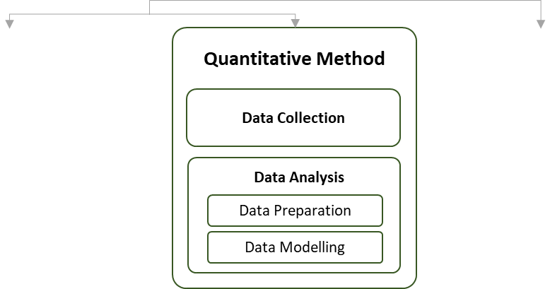
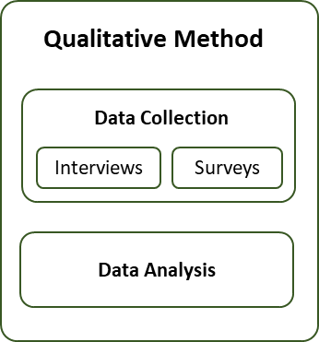
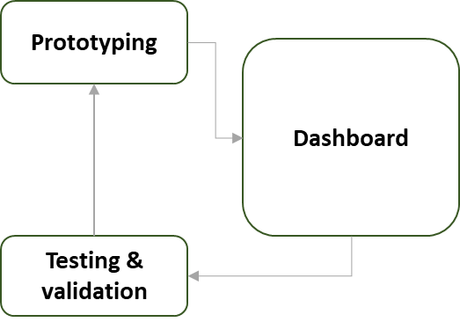
Project architecture
Fig: Mixed Method
Notes:
In this study we have used Mix method, so that we can increase the credibility of the POC also of our quantitative results. This method has helped use to broden our perpestive and identify key limitations.
In this we have performed Mix method in sequence, starting with Qualitative where we did interviews and surveys. And Performed Quantitative method with support of results from qualitative method.
Prototyping, testing and validation was the ongoing process while developing the dashboard.
To increase in credibility of the analysis and POC.
To identify the potential opportunities and scalability
Broaden the perspective and helped to identify several limitations to the study.
Use of one method’s outcome to develop hypotheses for other method.
Elaborate on the findings to support and validate the outcome.
By supporting analysis of Quantitative method using Qualitative method.
BROADENING PERSPECTIVE Observation can help bring statistical data to life, while conclusions drawn through experimentation can reveal a factor that wasn’t considered during observations (Malina, Nørreklit, and Selto, 2011, p. 63) (Advantages and Disadvantages – Mixed Methods Research (wordpress.com))

Slide 13

Qualitative Method

Slide 14

Qualitative Method
Interviews
Surveys
Understanding perspective of people regarding the POC.
Goal was to explore new KPIs and to validate the Literature based KPIs.
Total 9 semi-structured interviews were conducted and analyzed with use of Empathy map
It is performed after conducting the interviews.
Target audience for the interview, were the people who work in the corporates.
Survey are performed using Microsoft Forms utility.
The intention was to collect responses based on (Background, Knowledge, Spending behavior, Feelings, and Experience) ​
Total 36 responses were gathered from the people who work in the industry.
Notes:
Interviews are performed to (1) and what they think about the topic what the opportunities for such poc.
(2)
(3) Where all the participants were from the corportate so that we could have the relevant target audiance.
Our goal was to collect such response that could help us to understand what kind of person we are talking to, their knnwld about the study, how they spend and their feelings and experiences.
(1) Since we wanted to use KPI that are suggested in literature, we wanted to understand how people see those kpis in practice what they prefer and do they comeup with any new that could be feasible to use with the available data.
(2)
(3)
(4)

Slide 15

Quantitative Method

Slide 16
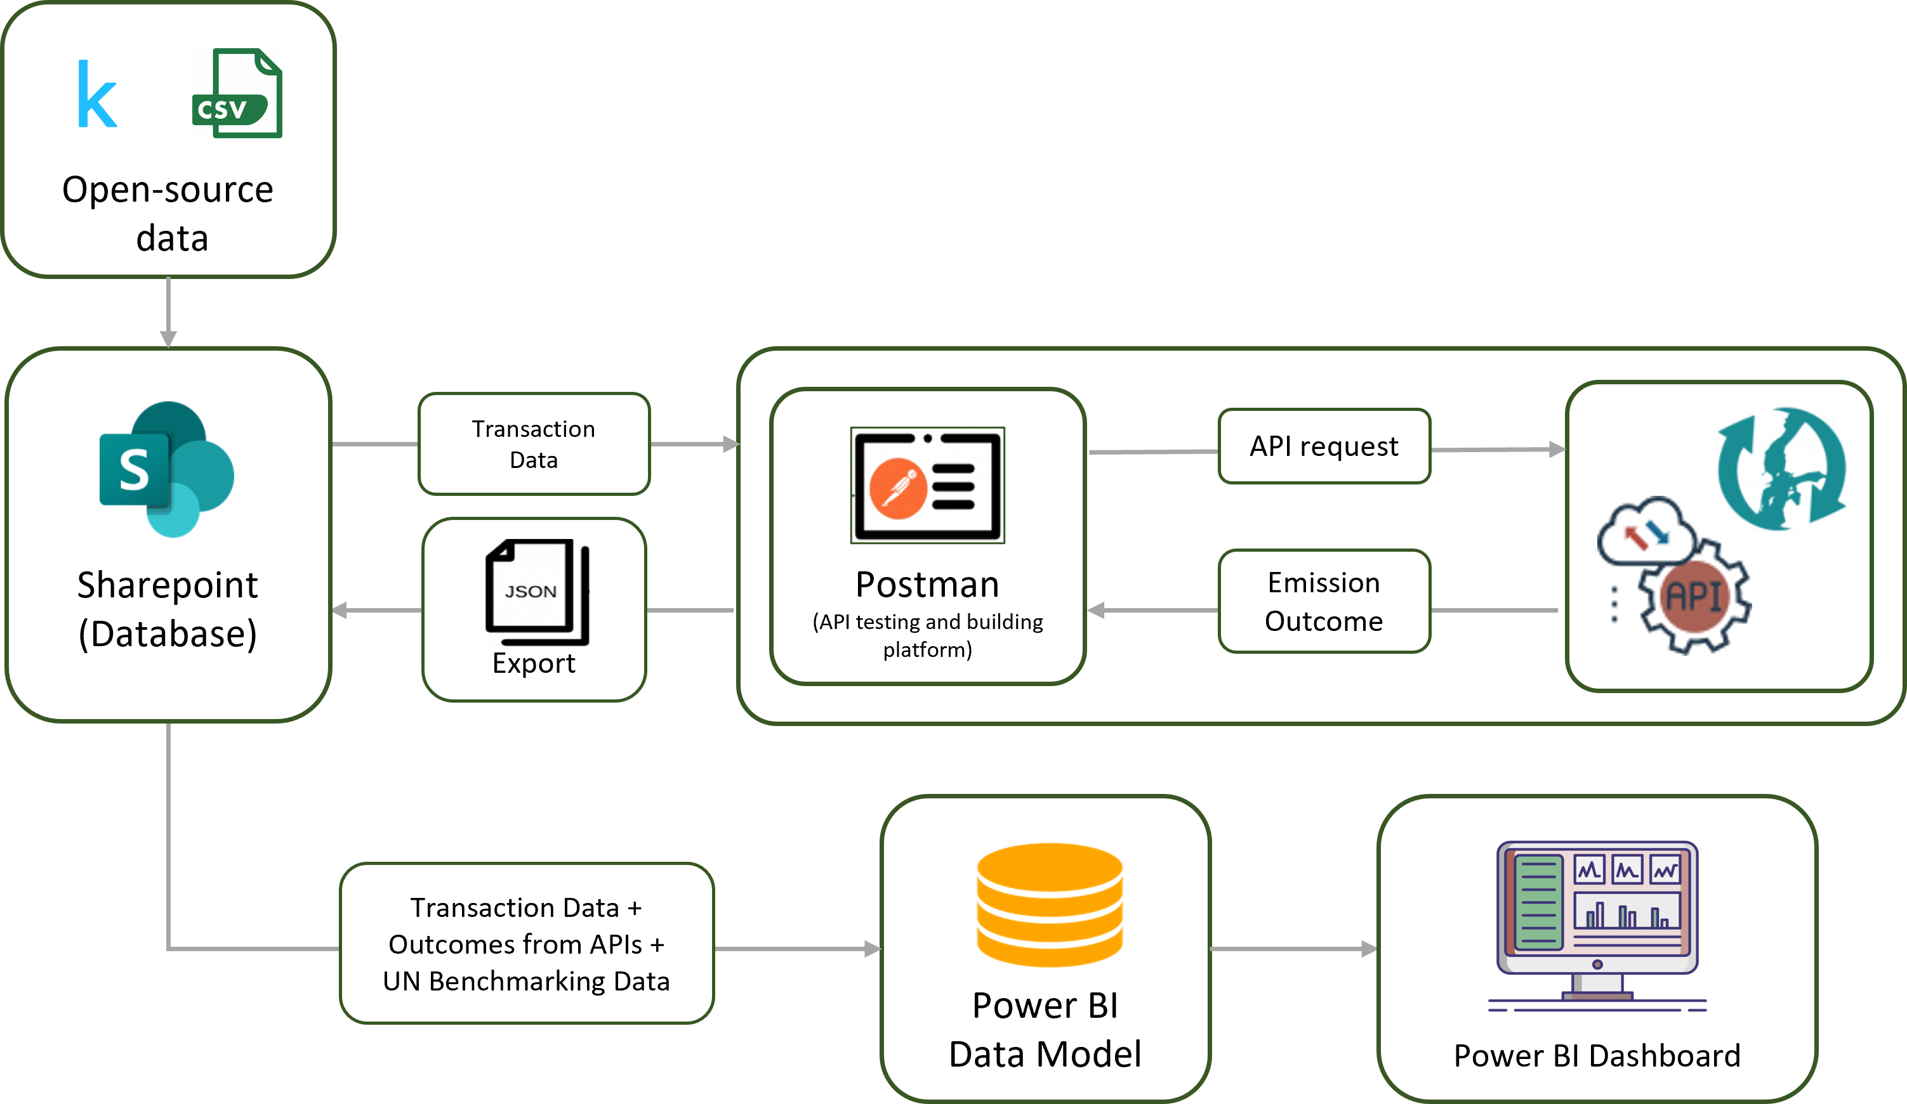
Quantitative method
Fig: Quantitative Method Wireframe
Notes:
Transaction data is collected from KAGGLE in .csv format
Transaction data is stored in SharePoint (acts as a database)
In order to receive the emissions outcome from Åland Index, a subset of data with merchant category code (mcc), reference ID, Transaction amount and currency is sent across POSTMAN
Collected response from API in the form of emission data is stored in SharePoint
All the collected data files from SharePoint are connected to Power BI Data model and at last, dashboard is developed on top of this data model.

Slide 17
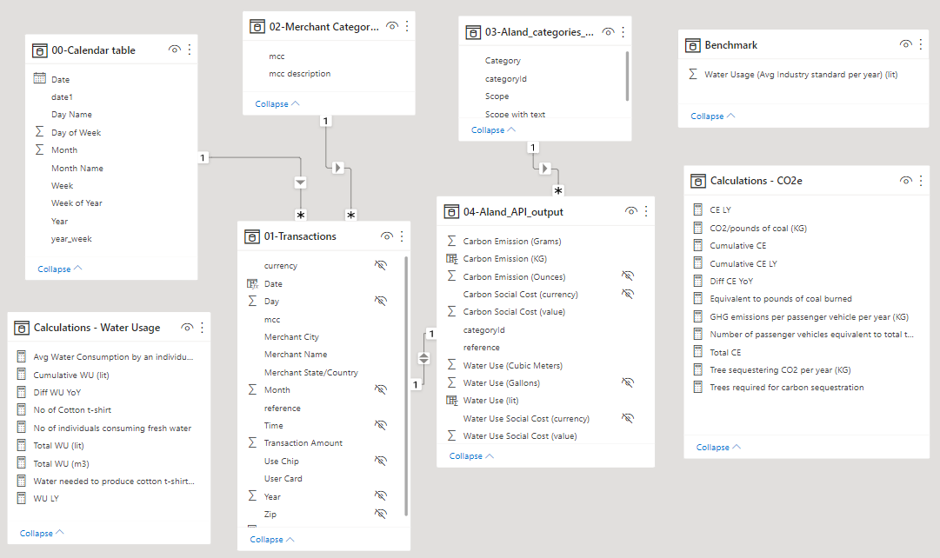
Data Model
Notes:
Collected all data sets
Added Benchmark data (UN data)
Added Cardinalities to table (lineage to fields)
Developed calculations for
CO₂e & water usage on top of fields from transaction and emissions outcome

Slide 18

04. rESULTS
Notes:
Interview, survey results and dashboard.

Slide 19

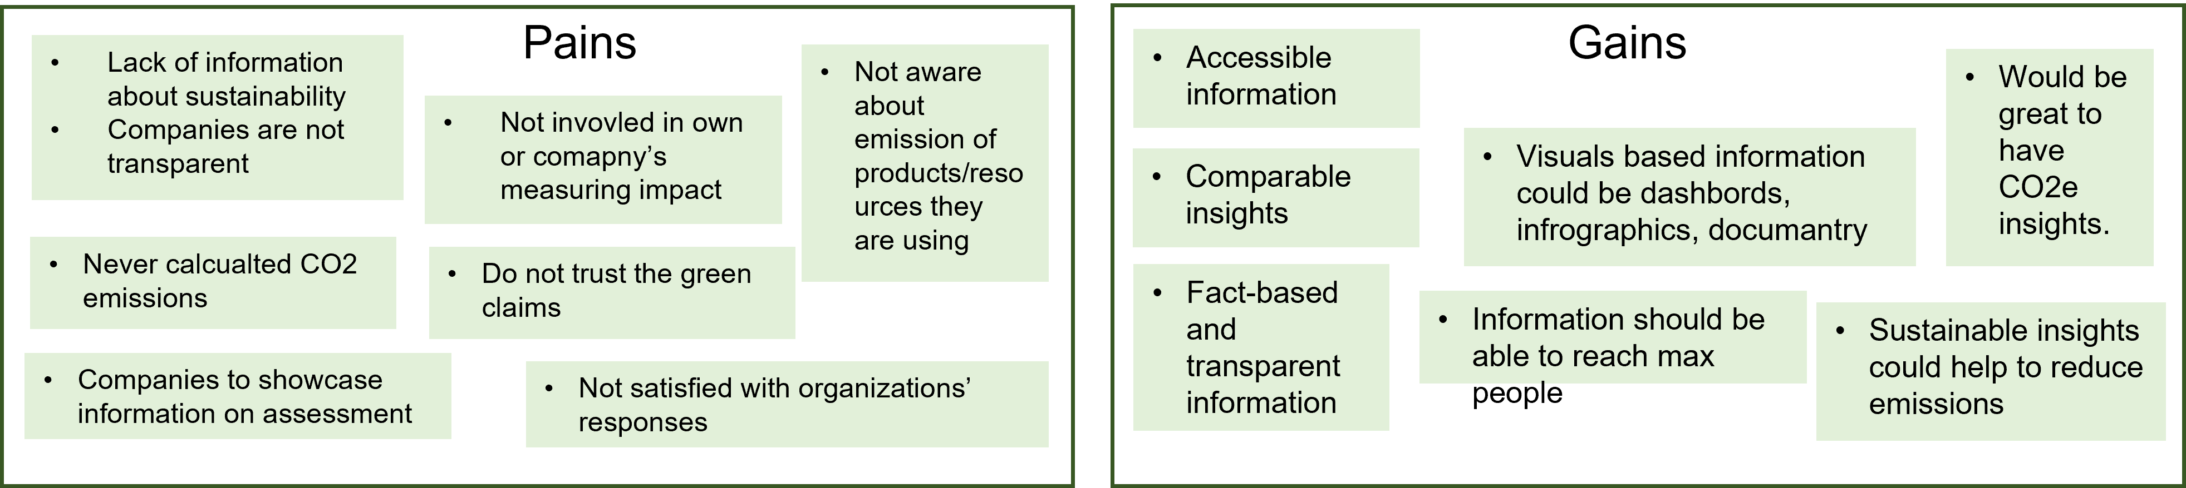
Interview Results
Addressed lack of information about sustainability.
Majority not satisfied with the claims from organizations.
Dissatisfaction with the organization’s assessment and response strategy.
Access fact-based and transparent information about the organization’s sustainability
Information on reduce emissions in the form of visuals, infographics or dashboard.
Notes:
We collected responses from the interviews, categorized them in Pains and Gains.
It was briefly observed from the Pains that, in general the respondents do address lack of information about sustainability while asked about it, majority of them as well mentioned that they are not satisfied with the claims from organizations, which leads to the dissatisfaction with the organization’s assessment and response strategy.
We understood from the Gains is that the respondents would like to access fact-based and transparent information about the organization’s sustainability, specifically, the insights which could help reduce emissions in the form of visuals, infographics or dashboard.

Slide 20
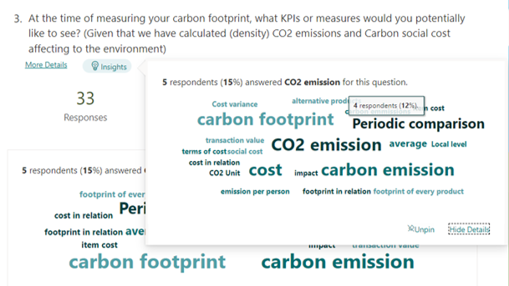
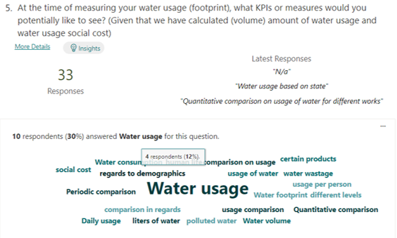
Survey Results
Majority of the respondents to know about carbon footprint, emissions cost, periodic comparison, emission per transaction, etc.
Majority of the respondents wanted water footprint, water usage, consumption per transactions, etc.
KPIs validated from the literature study
Notes:
Majority of the survey questions were objective, however, couple of questions were open-ended to understand the respondent’s interpretation, regarding the key performance indicators.
From the Q.3 responses, it can be observed that majority of the respondents wanted to get to know about carbon footprint, emissions cost, periodic comparison, emission per transaction, etc.
Whereas Q.5 responses pointed towards knowing about water footprint, water usage, periodic comparison, social cost, consumption per transactions, etc.

Slide 21

A picture is worth a thousand words
- Fred R. Barnard
Notes:
Over to dashboard

Slide 22

05.
dISCUSSION
Notes:
Discuss outcomes and limitations in brief

Slide 23

Key findings
Conventional methods are effective, however, requires extra effort, if an organization wants to measure the emissions on its own.
Activities: (i) Data collection,
(ii) (Selecting) calculation methods,
(iii) (Identifying) emission categories to determine emission factors.
Transaction based estimation provides historical and real-time insights.
Majorly existing Calculators do not offer transparent calculation.
Notes:
Transaction based estimation provides historic and realtime estimations.

Slide 24


Benefits
Consumption-based analysis approach
Systematic carbon reporting
Idea’s approach and flexibility
Efficient to analyze data and easy to understand interface
Limitations
Availability and initial gathering of EEIO Data for the project.
Developing an API to measure emissions.
Custom development of mitigation plan with the open-source data.
Notes:
Consumption-based analysis approach
Allows users to understand real-time estimations by tracking activities. (that costs more emissions to the environment)
Systematic carbon reporting
Transparent reporting could improve trust with the stakeholders and customers.
Idea’s approach and flexibility
Customization in the product allows measuring insights based on the change in requirement strategy.
Efficient to analyze data and easy to understand interface
Business Intelligence platforms are easily understandable with the executives and readily usable by the corporations.
Limitations 1. In this study gathering EEIO data within time was not possible due to legal agreements and data collection.
2. Developing an API being a time and labor-intensive task in the thesis, we had to use available authentic API to showcase calculations.
3. Due to the use of synthetic data, and not having a real-life case was difficult to develop a mitigation plan

Slide 25

06. conclusION
Notes:
Findings to action with

Slide 26


CONCLUSIONS
a
B
C
Estimation of footprints by using spend-based data (transaction data) has enabled the measurement of emissions in real-time.
Enable transparency between stakeholders, employees and customers of an organization and enroll themselves to take part in the Global initiative.
Assist organizations to measure emissions from business activities to ease the way of taking actions.

Slide 27
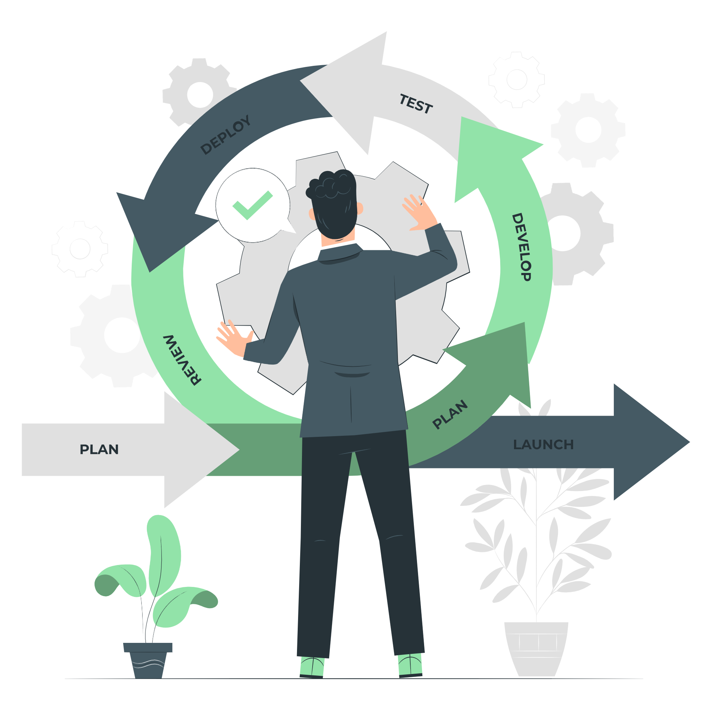
07.
Future scope
Notes:
Genuine future scope

Slide 28
Future scope
Develop an in-house API / calculator
Personalized recommender system
API could be developed by collecting EEIO data based on the region.
Providing end to end mitigation strategy based on the requirements.
A personalized recommender helps to choose the best content item.
Majorly beneficial for retail industries to make optimal positioning of a product or a service.

Slide 29

Thank You

Slide 30

Questions

Slide 31
A.
Appendix

Slide 32
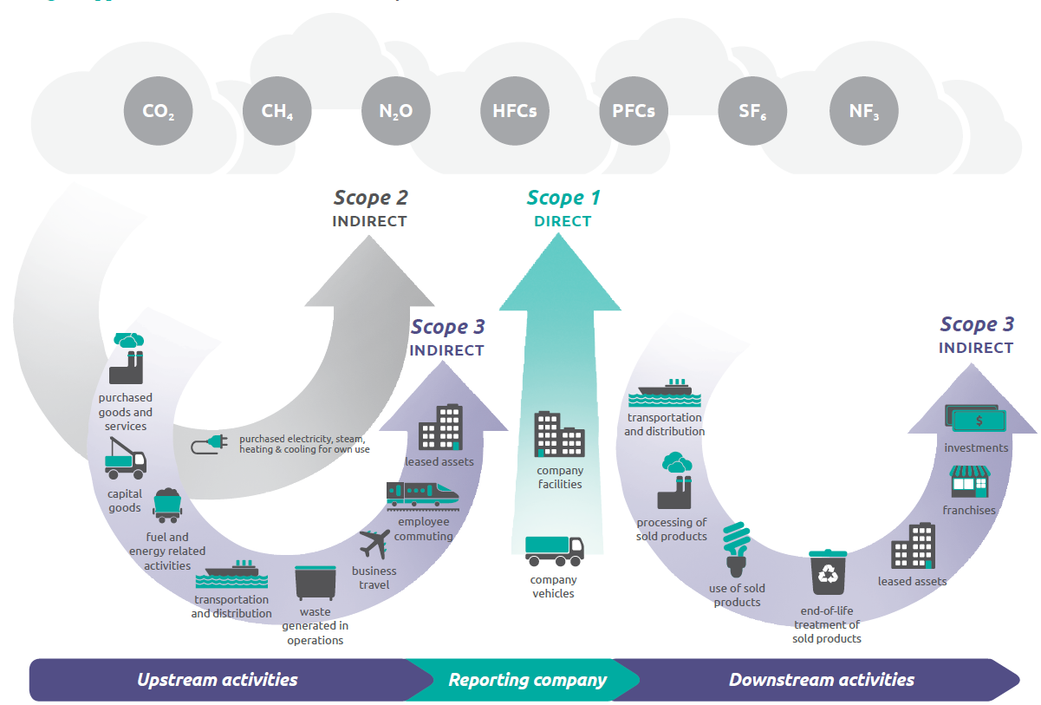
Existing literature
GHG Protocol Guidelines for calculation
GHG emissions
Relative Size of the emissions based on the scope 3 activity.
Company’s business goals.
Data availability.
Data quality.
Cost and effort required to apply each method.
Other criteria identified by the company.
Scope 1: Direct Emissions
Manufacturing, factories, or combustion emission activities owned or managed by an enterprise.
Scope 2: Indirect Emissions
Purchase of electricity, steam, heating, and cooling by the reporting firm, government, or non-governmental organization.
Scope 3: Other Indirect Emissions
Waste disposal, purchased goods, and materials, or transport, business travel, hotel stay, food consumption.
GHG Base calulation
GHG emission (CO₂e) =
Activity Data x Emission Factor (EF)
Notes:
Scope 1: Direct Emissions
Manufacturing, factories, or combustion emission activities owned or managed by an enterprise.
Scope 2: Indirect Emissions
Purchase of electricity, steam, heating, and cooling by the reporting firm, government, or non-governmental organization.
Scope 3: Other Indirect Emissions
Waste disposal, purchased goods, and materials, or transport, business travel, hotel stay, food consumption.
Greenhouse Gas Protocol (GHGP) is an internationally recognized standard for account-ing, measuring, and managing greenhouse gas emissions, as well as a training and calculat-ing tool for commercial, private, and government activities, and for taking mitigation steps[25].World Resources Institute (WRI)and theWorld Business Council for SustainableDevelopment (WBCSD)collaborated on the development of the GHGP [25]. These GHGemissions have been classified intoScopes 1, 2, and 3based on the source of their emis-sions [25].

Slide 33
Existing literature
GHG Protocol Guideline
GHG emissions
Relative Size of the emissions based on the scope 3 activity.
Company’s business goals.
Data availability.
Data quality.
Cost and effort required to apply each method.
Other criteria identified by the company.
Notes:
Scope 1: Direct Emissions
Manufacturing, factories, or combustion emission activities owned or managed by an enterprise.
Scope 2: Indirect Emissions
Purchase of electricity, steam, heating, and cooling by the reporting firm, government, or non-governmental organization.
Scope 3: Other Indirect Emissions
Waste disposal, purchased goods, and materials, or transport, business travel, hotel stay, food consumption.
Greenhouse Gas Protocol (GHGP) is an internationally recognized standard for account-ing, measuring, and managing greenhouse gas emissions, as well as a training and calculat-ing tool for commercial, private, and government activities, and for taking mitigation steps[25].World Resources Institute (WRI)and theWorld Business Council for SustainableDevelopment (WBCSD)collaborated on the development of the GHGP [25]. These GHGemissions have been classified intoScopes 1, 2, and 3based on the source of their emis-sions [25].

Slide 34
- Measures GHG emissions from the manufacturing, up-stream supply chain activities and end products.
- Provides an emission factor (EF) to estimate GHG emission.
- Estimating emission using EEIO on GHG emissions (per unit of revenue) for a certain type of industry/category.
EEIO
(Environmentally-extended input-output)
Merchant identifier mapped against categories & sub-categories.
Categories & sub-categories complies with EEIO data.
MCC linked across category & sub-category from EEIO model.
Weighted Carbon value evaluated for a particular category/sub-category per transaction.
Weighted Carbon value = EEIO Emission Factor (to be multiplied with transaction amount for evaluating emissions)
Role of MCC (Merchant Category code)
Notes:
W = yearly revenue for a merchant or company( revenue used as a weight.
X = Carbon emission Value (sum of scope 1 2 3) for company x
Divide by total revenue. denoting (x) as the sum of carbon emissions of the company (Sum of scope 1,2 & 3) was yearly revenue for a merchant or company.
he estimation of emission using EEIO models measures is based on the GHG emissions per unit of revenue for a certain type of industry. Forinstance, 1 tonne of CO2(e) is emitted of $1 million revenue for a car manufacturing company, which implies that 1 tonne of CO2(e) is emitted at the time of all upstream supply chain activities, in regards to generating $1 million revenue.

Slide 35
Merchant identifier mapped against categories & sub-categories.
Categories & sub-categories complies with EEIO data.
MCC linked across category & sub-category from EEIO model.
Weighted Carbon value evaluated for a particular category/sub-category per transaction.
Weighted Carbon value = EEIO Emission Factor (to be multiplied with transaction amount for evaluating emissions)
Role of MCC (Merchant Category code)

Slide 36
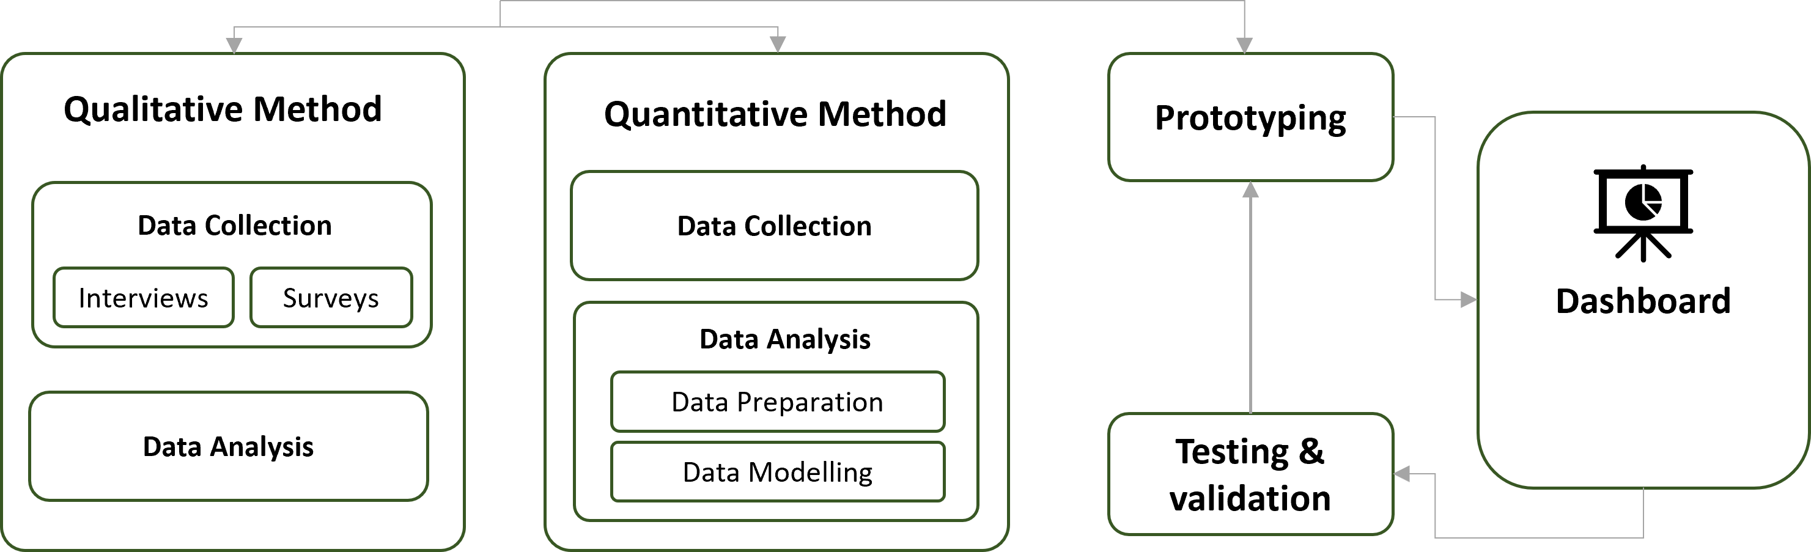
Project architecture
To increase in credibility of the analysis and POC.
To identify the potential opportunities and scalability for the POC.
Broaden the perspective and helped to identify several limitations to the study.
Use of one method’s outcome to develop hypotheses for other method.
Elaborate on the findings to support and validate the outcome.
By supporting analysis of Quantitative method using Qualitative method.
Sequential method is incorporated to collect data and perform analysis.
Fig: Mixed Method
Notes:
BROADENING PERSPECTIVE Observation can help bring statistical data to life, while conclusions drawn through experimentation can reveal a factor that wasn’t considered during observations (Malina, Nørreklit, and Selto, 2011, p. 63) (Advantages and Disadvantages – Mixed Methods Research (wordpress.com))

Slide 37
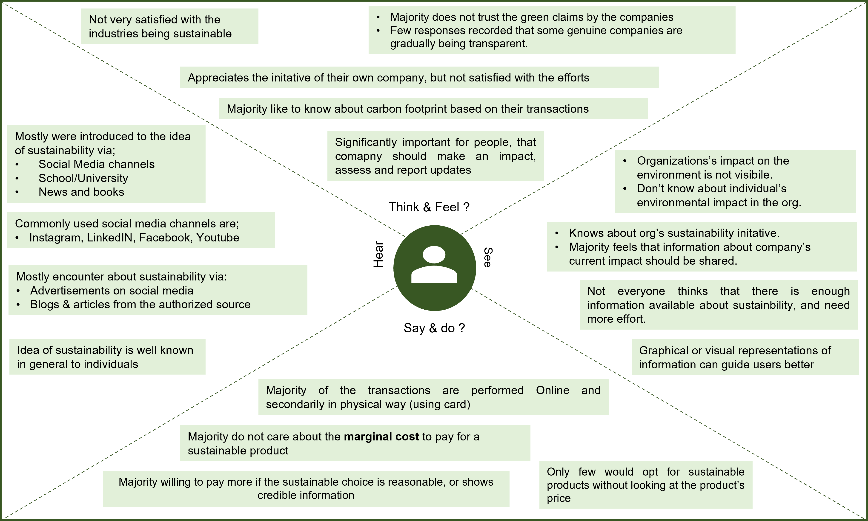
Qualitative Method: Interviews
Notes:
Coding of the all interviews is performed based on the interpretation of the responses.
These responses were incorporated in an empathy map.
Empathy map based analysis is performed to understand prepestive of participants from different perspectives.
It is used as tool to gain insights from different dimensions to support the decision for devloping the POC.

Slide 38
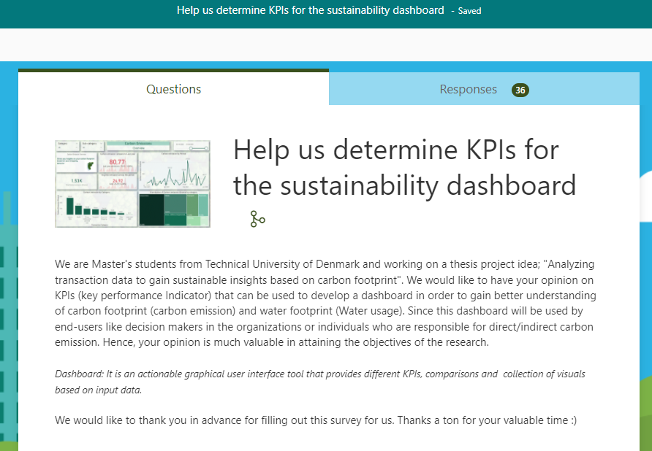
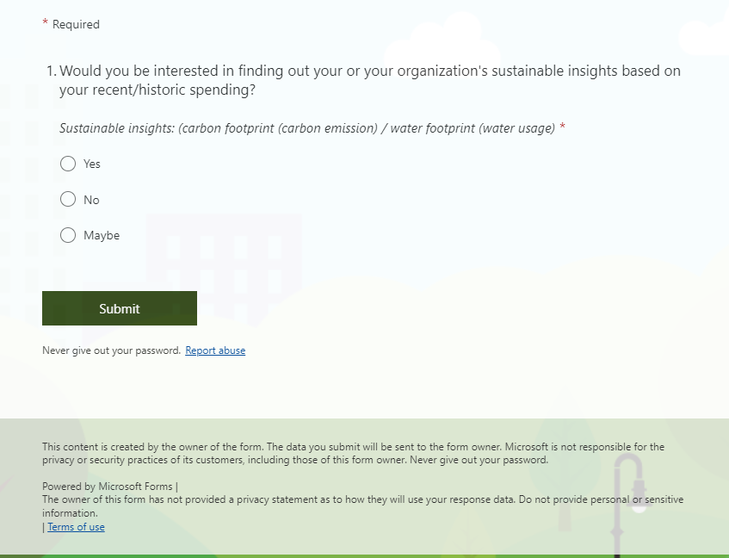
Qualitative Method: Survey
Notes:
Survey are perfomed using Microsoft Forms utility.
- It’s feautres, optimized data collection and analysis was best suited for the requirements of the project.
It is performed after conducting the interviews and identifying literature based KPIs.
Aim was to understand the preference of KPIs that people would like to see in the dashboard.
Also, to explore new KPIs and to validate the Literature based KPIs.
Total 36 responses were gathered over the period of study.

Slide 39
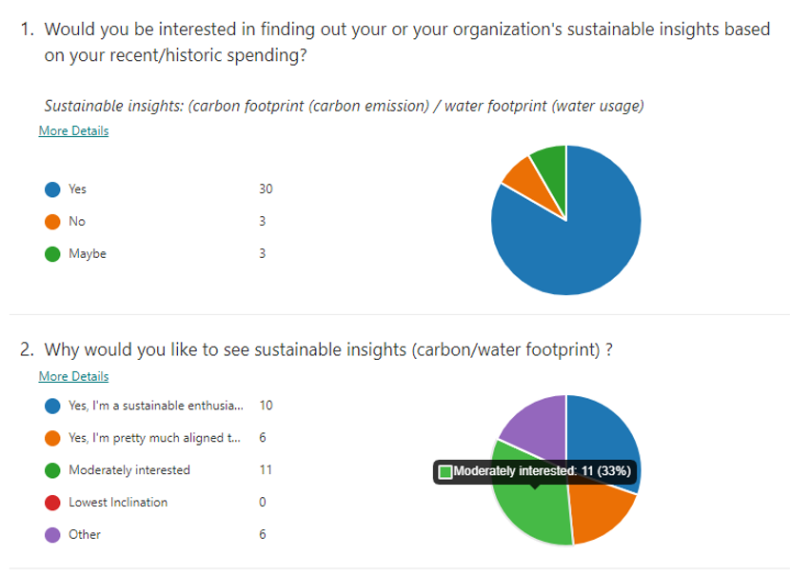
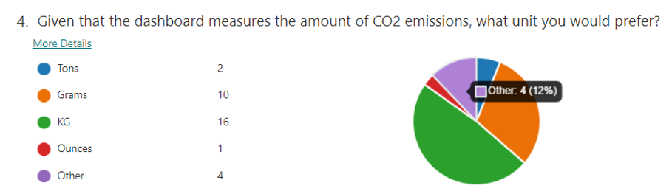
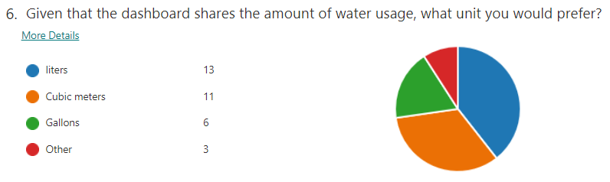
Survey Results

Slide 40
Survey Results

Slide 41
Survey results
Carbon Footprint
Water Footprint
KPIs / Key Visuals | Dashboard visuals
CO₂ emissions | Total Carbon Footprint (KG)
Carbon footprint of each of my purchases | Based on the selected time interval, an individual can choose to see the amount of carbon footprint, generated by total transactions
Periodic comparison of my carbon emission | Last year emissions (compared to last year)
Cost per CO₂ Unit | Carbon Social cost (USD) - calculated to a reference level/transaction level if want to
How much I’m harming the planet in terms of cost (ii) in terms of CO₂ emission | (i) Carbon Social cost (USD), (ii) a graph comparing carbon social cost vs associated carbon emission
Comparison of transaction value against Carbon social cost (Money spent / month) | Transaction Amount against Carbon Social Cost per transaction
KPIs / Key Visuals | Dashboard visuals
Water usage | Total Water Consumption (lit)
Periodic comparison of my water usage | Last year emissions (compared to last year)
consumption compared to other peers | Card KPIs showing comparison of total water consumption, equivalent to number of individuals consuming water and production of cotton t-shirts
Water consumption and wastage rate | Water usage compared to Industry Benchmark

Slide 42
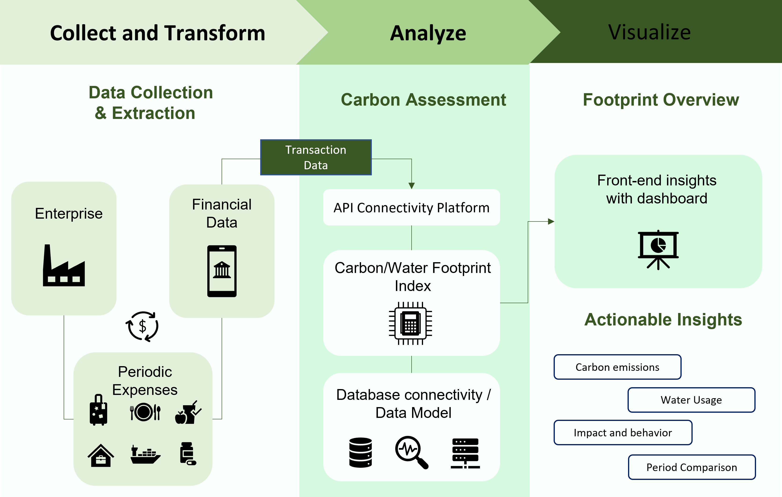
Implementation oplan
Implementation plan

Slide 43
Benefits
Consumption-based analysis approach
Allows users to understand their spending behavior.
Keep track of activities that costs more emissions to the environment.
Systematic carbon reporting
Provide transparent emission data for reporting frameworks (ex; GRI).
Relations with stakeholders and customers projected to be improved.
Idea’s approach and flexibility
Customization allows measuring insights based on the change in requirement strategy.
Reduction in errors and uncertainties
Collected transaction data bypasses the uncertain self-assessed/manually entered data.
Automated results inheriting low frequency of errors.

Slide 44

Limitations
Calculations are dependent on measurable variable (ex; mcc -> EEIO -> EF)
Availability of Data.
Custom development of mitigation plan/actionable insights might exert time and affiliated resources.

Slide 45
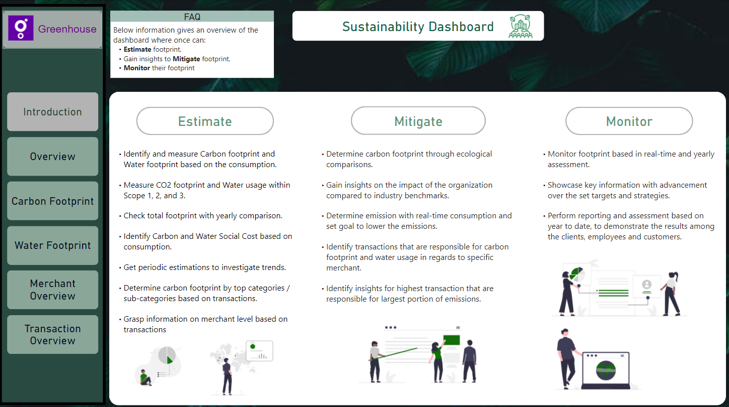
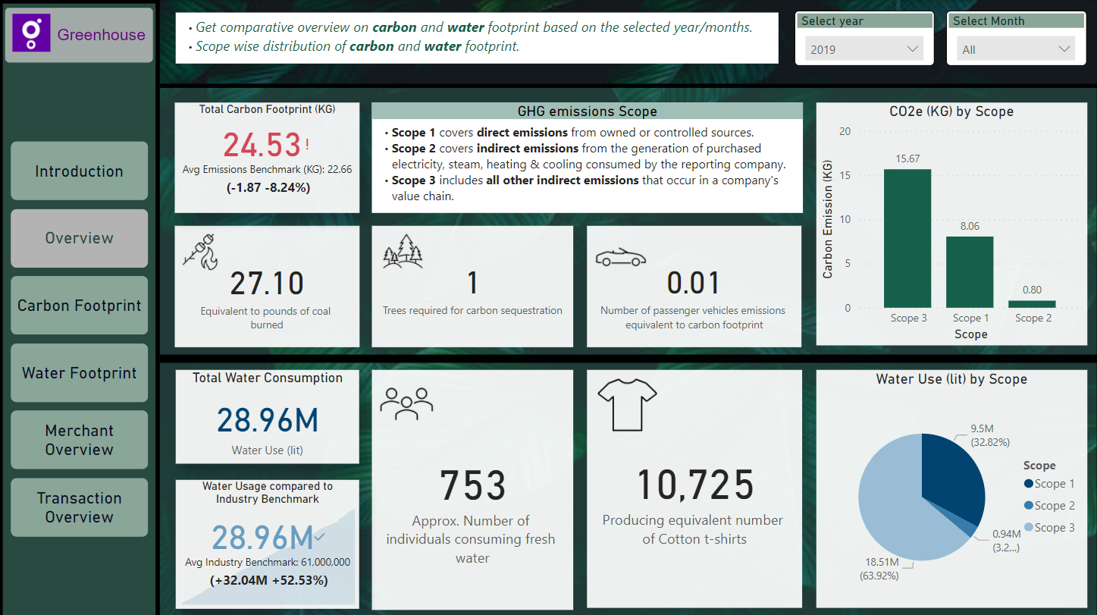
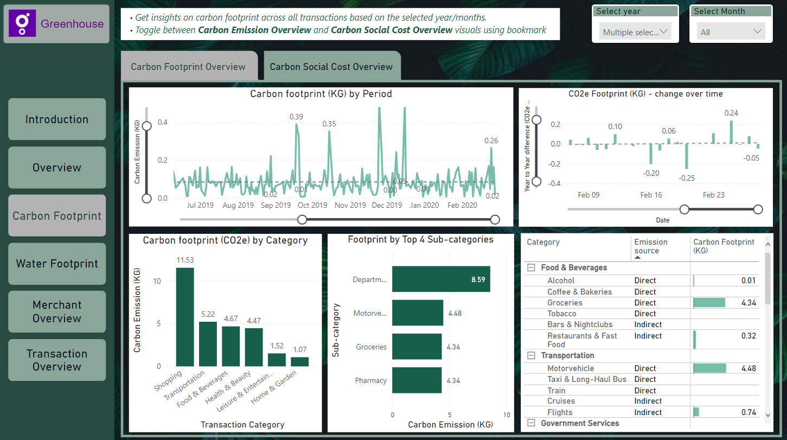
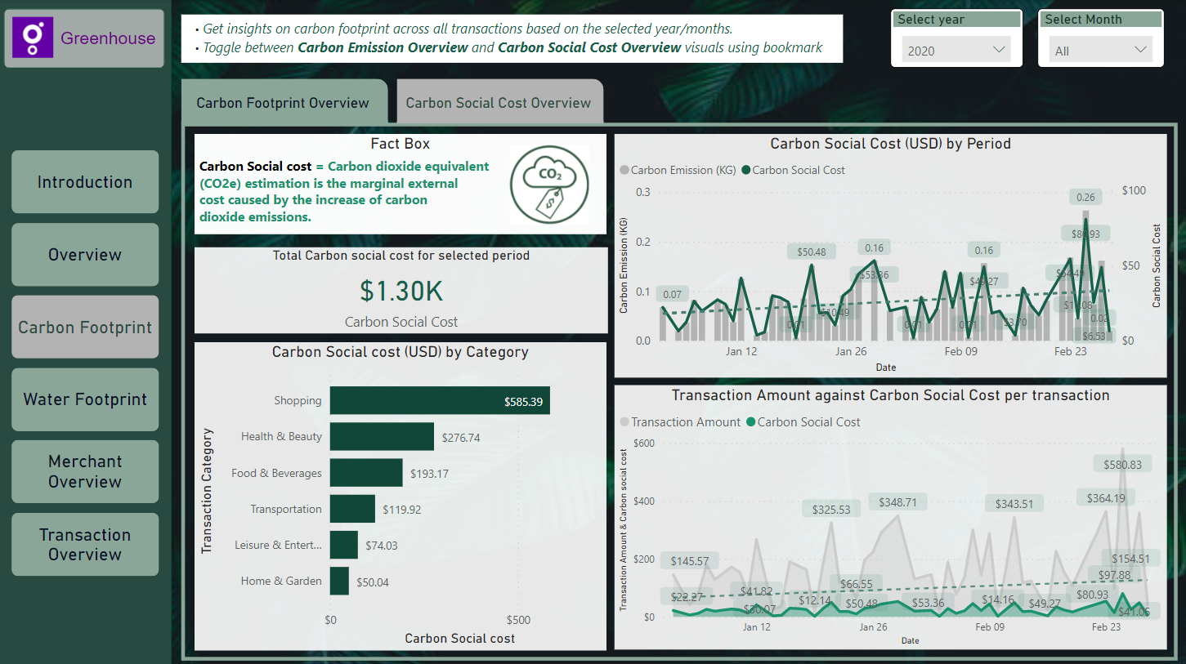
iNTRODUCTION
Dashboard
overview
Carbon Footprint / Social cost Overview

Slide 46
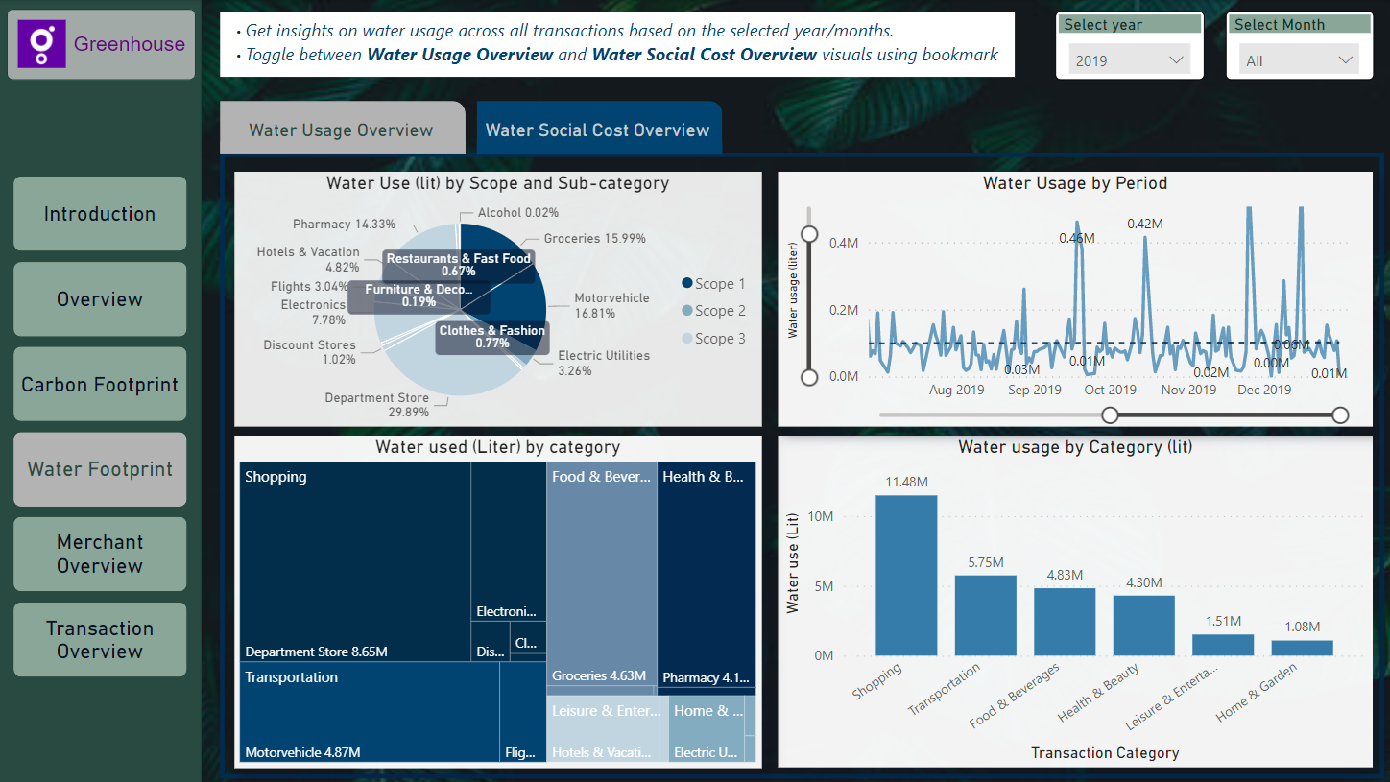
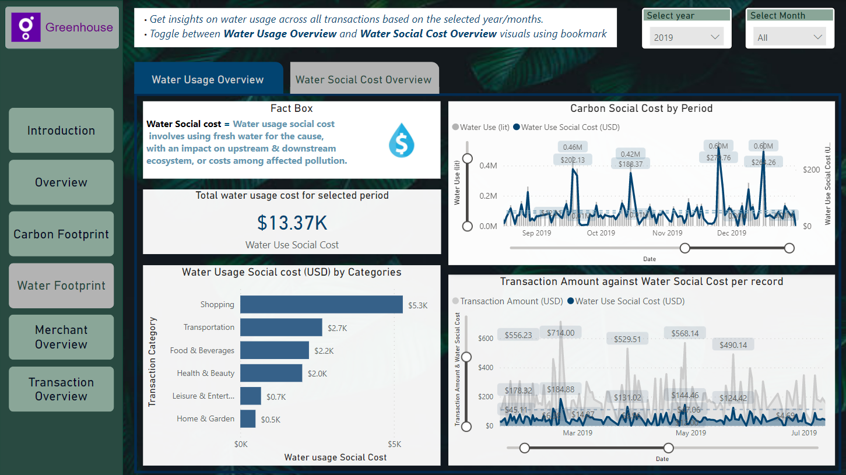
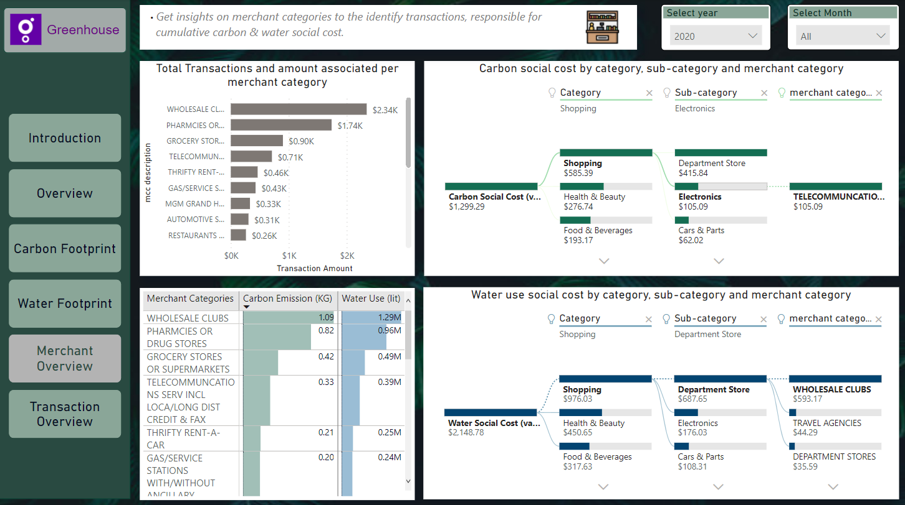
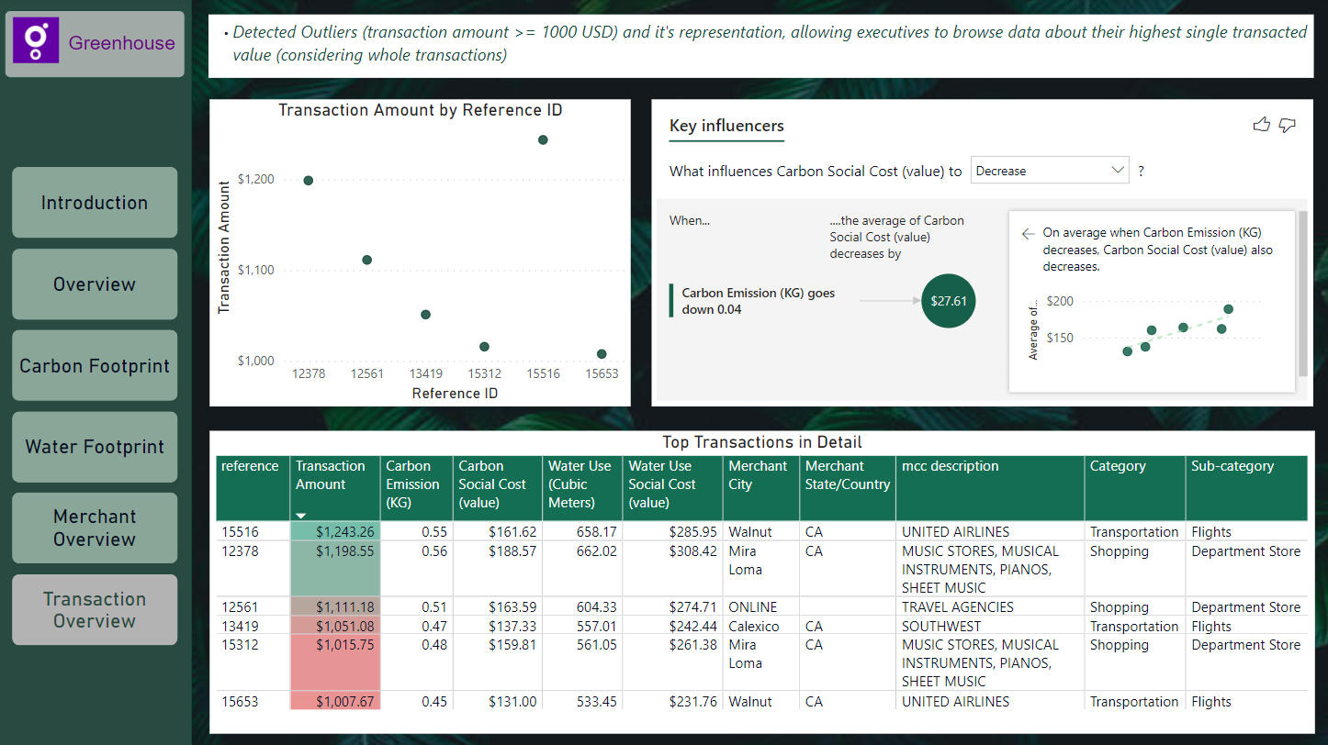
Dashboard
Water Footprint / Social cost Overview
MERCHANT overview
TRANSACTION overview

Slide 47
Quantitative method
Fig: Quantitative Method Wireframe

Slide 48
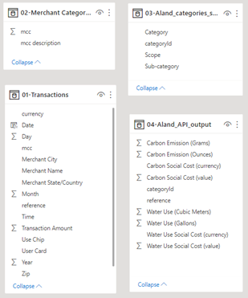
Quantitative Data collection
Determining important fields for further calculation
Transaction Data file (01 file)
MCC
Transaction Amount
Transaction Currency
Reference ID
Åland API file (04 file)
Carbon Emission (Grams)
Carbon Emission (Ounces)
Carbon Social Cost (value)
Category ID
Water Use (m³)
Water Use (Gallons)
Water Use Social Cost (value)
Reference ID
Merchant Category Code file (02 file)
MCC
MCC Description
Åland categories file (03 file)
Category ID
Category
Sub-category

Slide 49
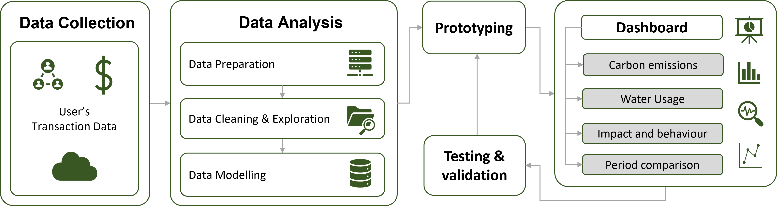
Quantitative MEthod

Slide 50
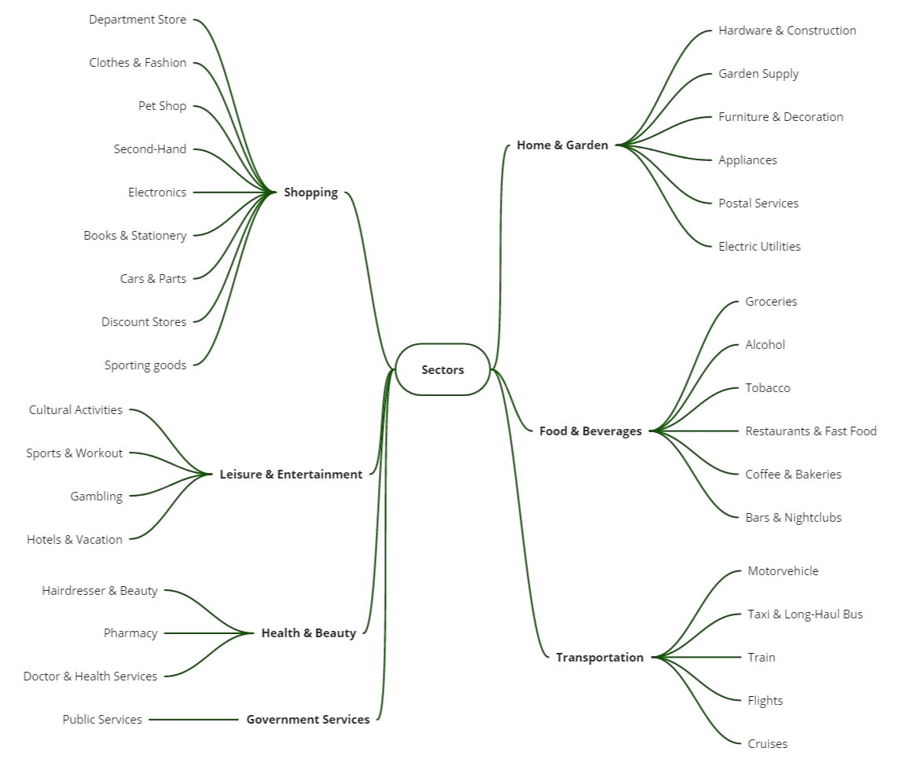

Slide 51
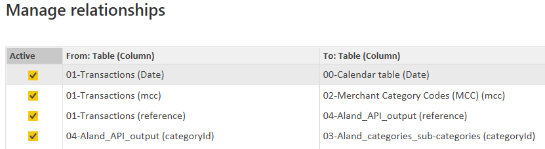
Cardinality check
Other important fields;
Merchant Category Code file (02 file)
MCC
MCC Description
Åland categories file (03 file)
categoryID
Category
Sub-category

Slide 52
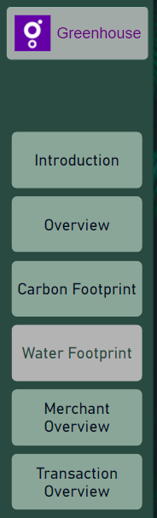
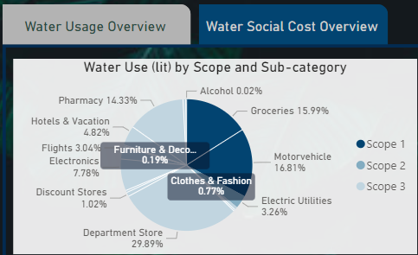

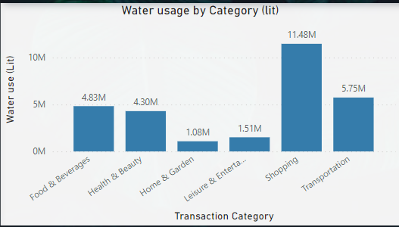
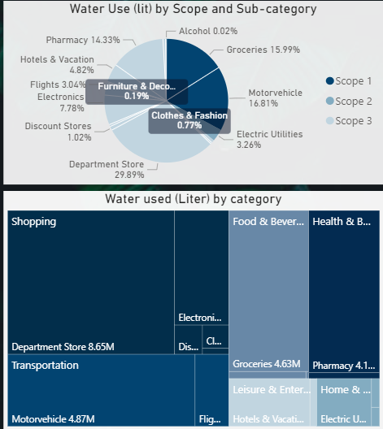
Scaling the solution
Desktop Solution
Mobile Solution
Solution can be scaled to a service (on-premise) solution within enterprises
Solution can be shared across the enterprise for information in a mobile application

Slide 53

04.
analysis
Notes:
List of results. Could be the empathy map and survey results
Not sure what to show in the quantitative part?
API connection (data prep & collection)
final data model (star schema from Power BI) ?

Slide 54


Qualitative Method: Interviews
Background
Demographics of the participants
Knowledge
What people know about sustainability.
Behaviour
Spending behaviour and their preferences.
Feelings
Experience
Current difficulties and what they are seeking as solution.
Opinion of the current sustainable strategies
Company’s and their own impact on the environment.
Influence throught information
Notes:
Understanding perspective of people with qualitative method in order to make contextual decisions for the study.
9 semi-strucutred interviews were conducted.
Interviews were conducted in a hybrid way.
An interview guide is developed that contains set of question based on 5 different objectives.
Data was collected by making hand-written transcripts.

Slide 55
Existing literature
Environmental KPIs
MCC (Merchant Category code)
EEIO
(Environmentally-extended input-output)
Green house gas emissions
Indicators comparing the sustainability measures across the time series.
Periodic comparison to measure progress
Measures GHG emissions from the manufacturing, up-stream supply chain activities and end products.
Provides an emission factor (EF) to estimate GHG emission.
Estimating emission using EEIO on GHG emissions (per unit of revenue) for a certain type of industry/category.
Merchant identifier mapped against categories & sub-categories.
Categories & sub-categories complies with EEIO data.
MCC linked across category & sub-category from EEIO model.
Weighted Carbon value evaluated for a particular category/sub-category per transaction.
Weighted Carbon value = EEIO Emission Factor (to be multiplied with transaction amount for evaluating emissions)

Slide 56
MOTIVATION
Analyze transaction data to develop an interactive user-accessible dashboard that shows sustainable insights.
Notes:
What is the topic area that you are investigating?
What are the specific research questions that you set out to answer?
Research questions (Kasper)
Why is this question important to answer?
The need for this study – motivation (Kasper)
What were the objectives of your research?

Slide 57
CONCLUSIONS
a
B
C
Suggested approach to estimate footprints by using spend-based data (transaction data) has enabled the measurement of emissions in real-time.
Suggested approach can assist organizations to measure, mitigate and manage emissions from business activities to ease the way of taking actions.
Suggested approach to enable transparency between stakeholders of the organization and enroll themselves to take part in the Global initiative.

Slide 58
Future scope
Develop an in-house API / calculator
Personalized recommender system
A factual calculator with legit information about upstream / downstream activities and aggregations strengthening the data transparency agenda with increased trustworthiness within the individuals.
A personalized recommender helping application choose the best content item to show its users.
Optimal positioning of a
product or a service.

Slide 59

A picture is worth a thousand words
- Fred R. Barnard

Slide 60
BIBLIOGRAPHY
AUTHOR | Year | Title of the publication. Publisher
AUTHOR | Year | Title of the publication. Publisher
AUTHOR | Year | Title of the publication. Publisher
AUTHOR | Year | Title of the publication. Publisher
AUTHOR | Year | Title of the publication. Publisher

